Slide 1


Monitoring of Driver Distraction from physiological and visual aspect
Using ML and DL Algorithms
Aditya Narayan
2020SC04058

Slide 2
Abstract
Driver drowsiness has become one of the main reasons for large number of road accidents.
The main aim of this project is to overcome the problem of road accidents which are related to drivers experiencing tiredness leads to a need arises to design a system that keeps the driver focused on the road.
With the evolution and improvement in Computer Vision, Opencv and CNN technologies,mart/intelligent cameras are developed to predict drowsiness in drivers, thereby alerting drivers which in turn reduce accidents when they are feeling drowsy.

Slide 3
Introduction
Drowsiness of the drivers is one of the key issues for majority of road accidents.
Most of the accidents happen in India due to the lack of concentration of the driver. Performance of the driver gradually deteriorates owing to drowsiness.
To avoid this anomaly, we developed a system that is able to
detect the drowsiness nature of the driver and alert him.

Slide 4
Problem Statement
Current drowsiness detection systems monitoring the driver’s condition requires complex computation and expensive equipment, not comfortable to wear during driving and is not suitable for driving conditions.
For example, Electroencephalography (EEG) and Electrocardiography (ECG), i. e. detecting the brain frequency and measuring the rhythm of heart, respectively.
A drowsiness detection system which use a camera is more suitable to be use but the physical signs that will indicate drowsiness need to be located first in order to come up with a drowsiness detection algorithm that is reliable and accurate.

Slide 5
Objective
The main idea of this project is to plan a system to distinguish driver's sluggishness by persistently checking the facial expressions of the driver by facial landmark detection concept.
The objectives of the project are as follows:
To identify eye closure of the driver and by estimating the Eye Aspect Ratio (EAR) value.
To identify mouth opening (yawning) of the driver by calculating Mouth Aspect Ratio (MAR) value.
To identify the head tilt of the driver by calculating the Euler angles with respect to rotational motion of the head.
To alert the driver upon identifying the drowsiness.

Slide 6
Overview
Drowsiness detection is a system that helps to provide safety and
accident prevention. The proposed system is a driver drowsiness
prediction system that will identify various scenarios. It will capture
closed eyes, open mouth, head pose hands-on eyes or mouth while
nodding or yawning etc. It will also detect whether the person is
yawning or trying not to fall asleep by the innate actions such as
making eyes broad from normal size and rubbing eyes with a hand.
An image of the driver captured through the camera serves as the
system's input. Furthermore, the face will be identified and cropped
from the image with created Region of Interest (ROI). This will be
followed by detection of eyes and mouth from ROI.

Slide 7
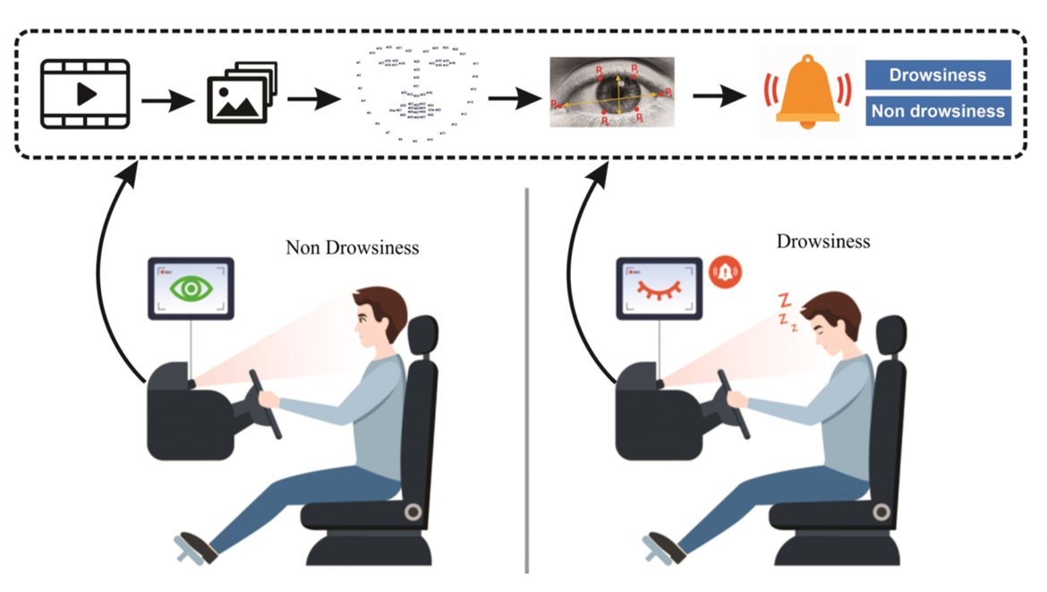
Case Study

Slide 8
Architecture
In order to detect the drowsiness the first step is to detect the face taken by the camera.
Then the facial expressions like the eye closure, yawning, head position is detected by Facial landmark detection concept.
The eye closure is detected by estimating Eye Aspect Ratio (EAR).When EAR goes below the threshold value, drowsiness is confirmed and driver is alerted.
The yawn detection is carried out by estimating Mouth Aspect Ratio (MAR).When MAR value goes above the threshold value, yawning is confirmed.

Slide 9
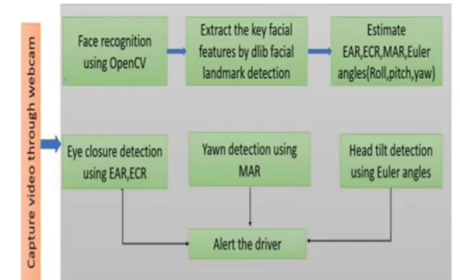
Architecture
The head tilt is detected by calculating the Euler angle. When goes below or goes above thresholds, head tilt is detected.

Slide 10
Methodology
The project is carried out in openCV and CNN environment using dlib facial landmark detector.
(i)Facial Landmarks detection
(ii)Eye Closure Detection
(iii)Eye Aspect Ratio
(iv)Yawn Detection
(v)Mouth Aspect Ratio
(vi)Head Pose Detection

Slide 11
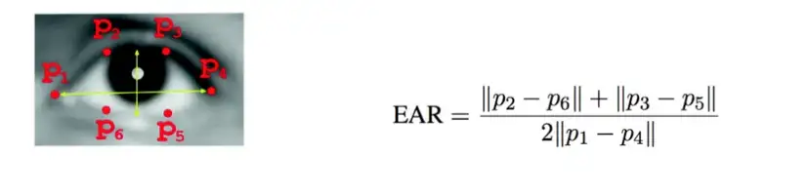
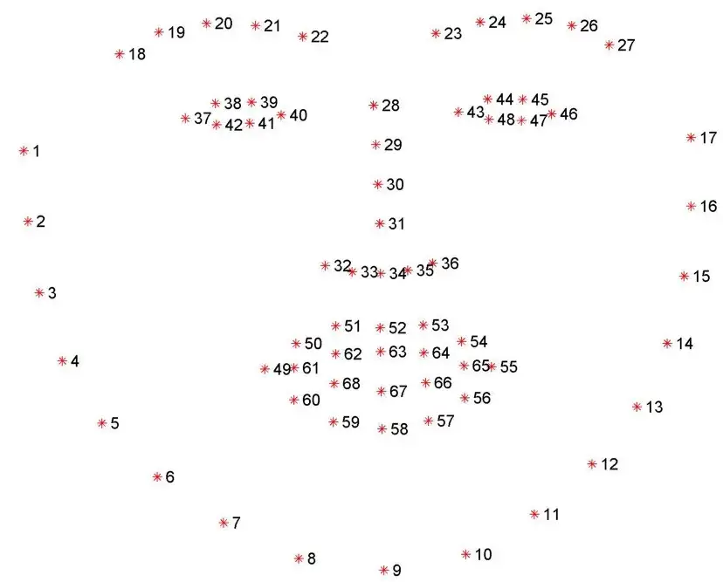
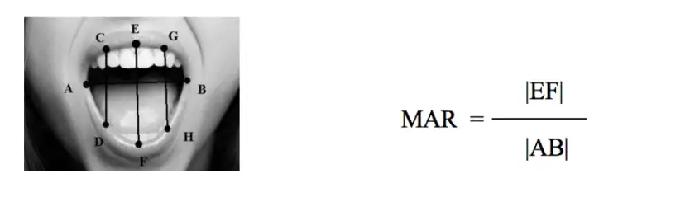
Methodology

Slide 12
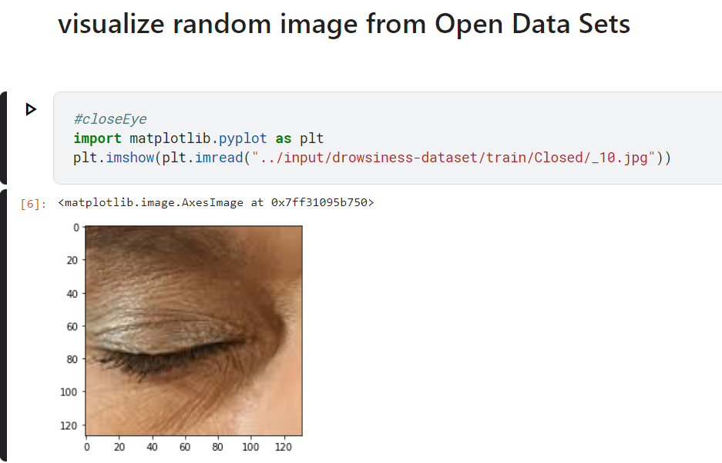
Result

Slide 13
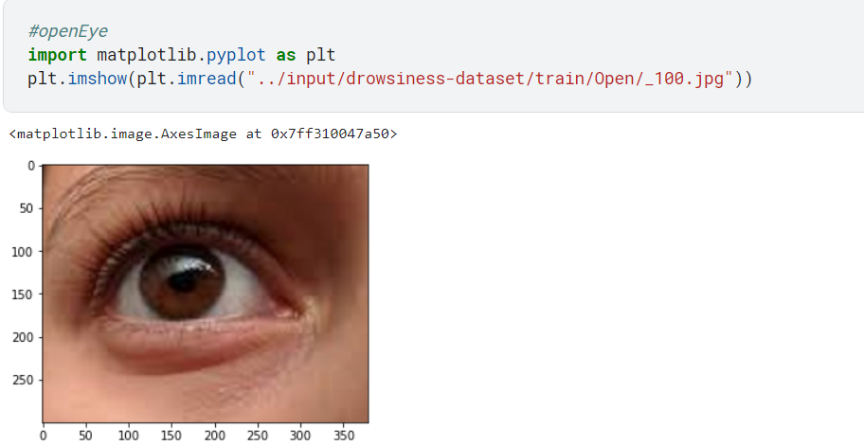
Result

Slide 14
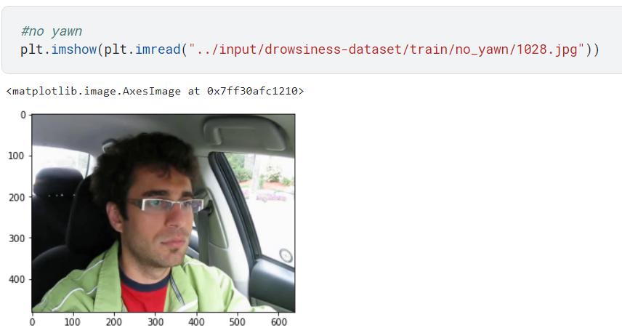
Result

Slide 15
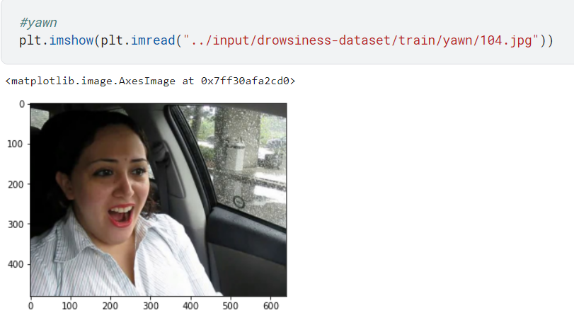
Result

Slide 16
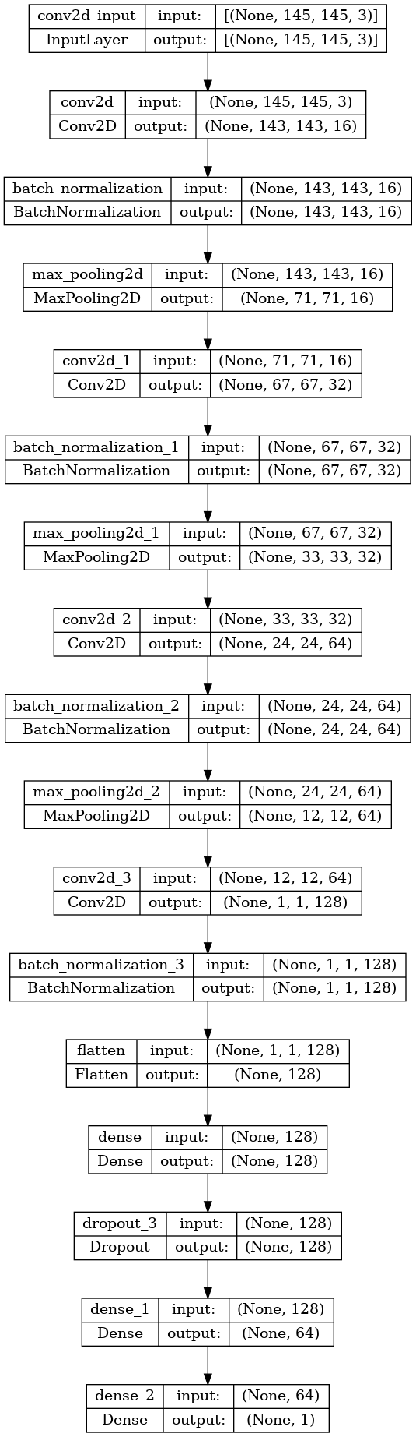
Visualizing our CNN architecture

Slide 17
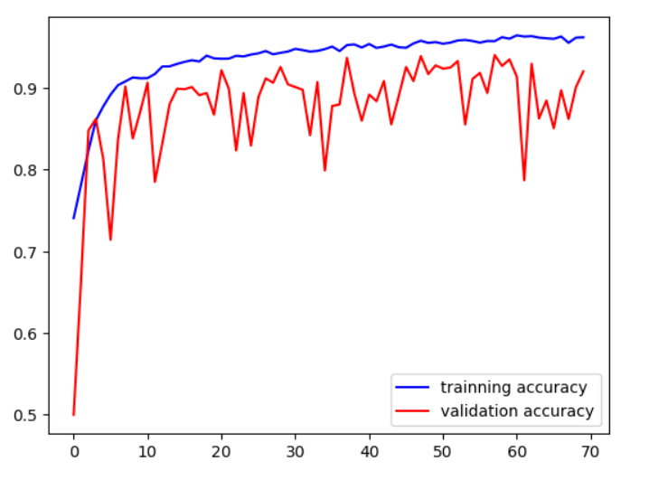
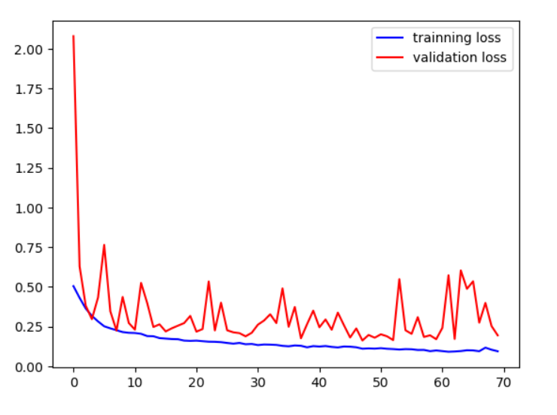
Data Training and Validation (CNN)

Slide 18
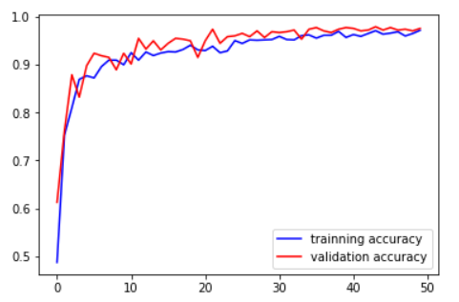
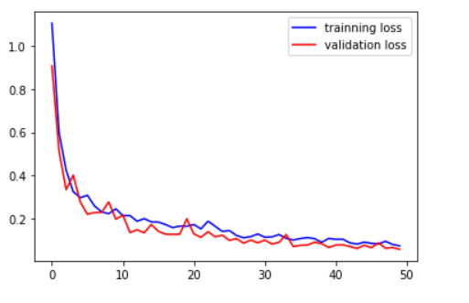
Data Training and Validation (OpenCV)

Slide 19
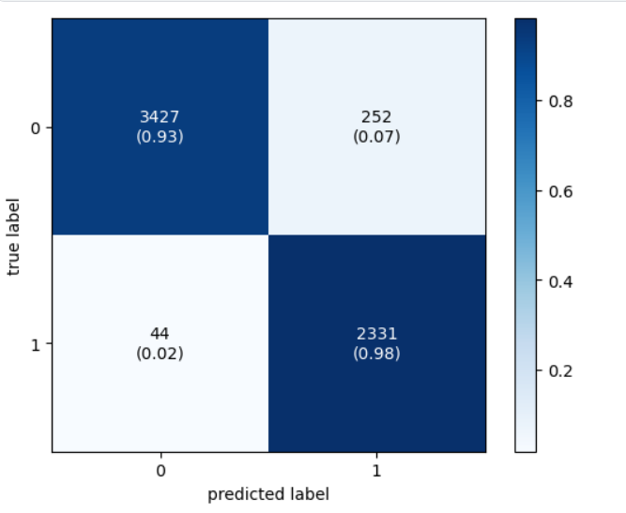
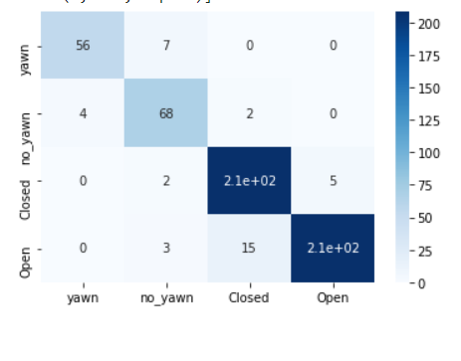
Confusion Matrix
CNN 2D OpenCV

Slide 20
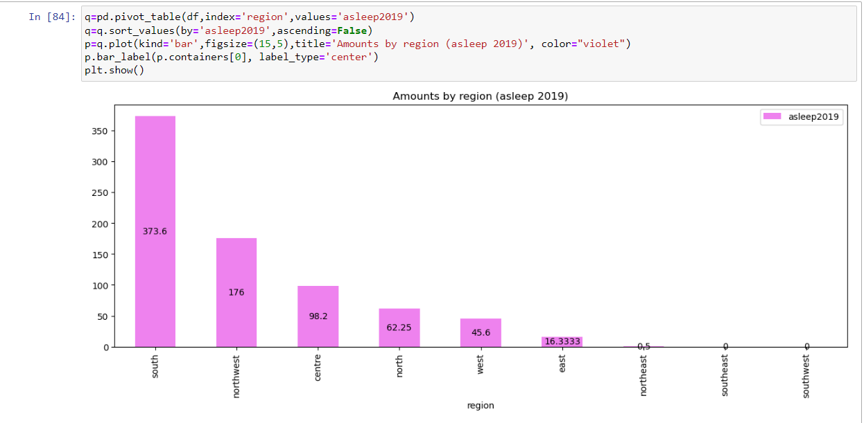
Statistics of Road Accident Caused By Drowsiness

Slide 21
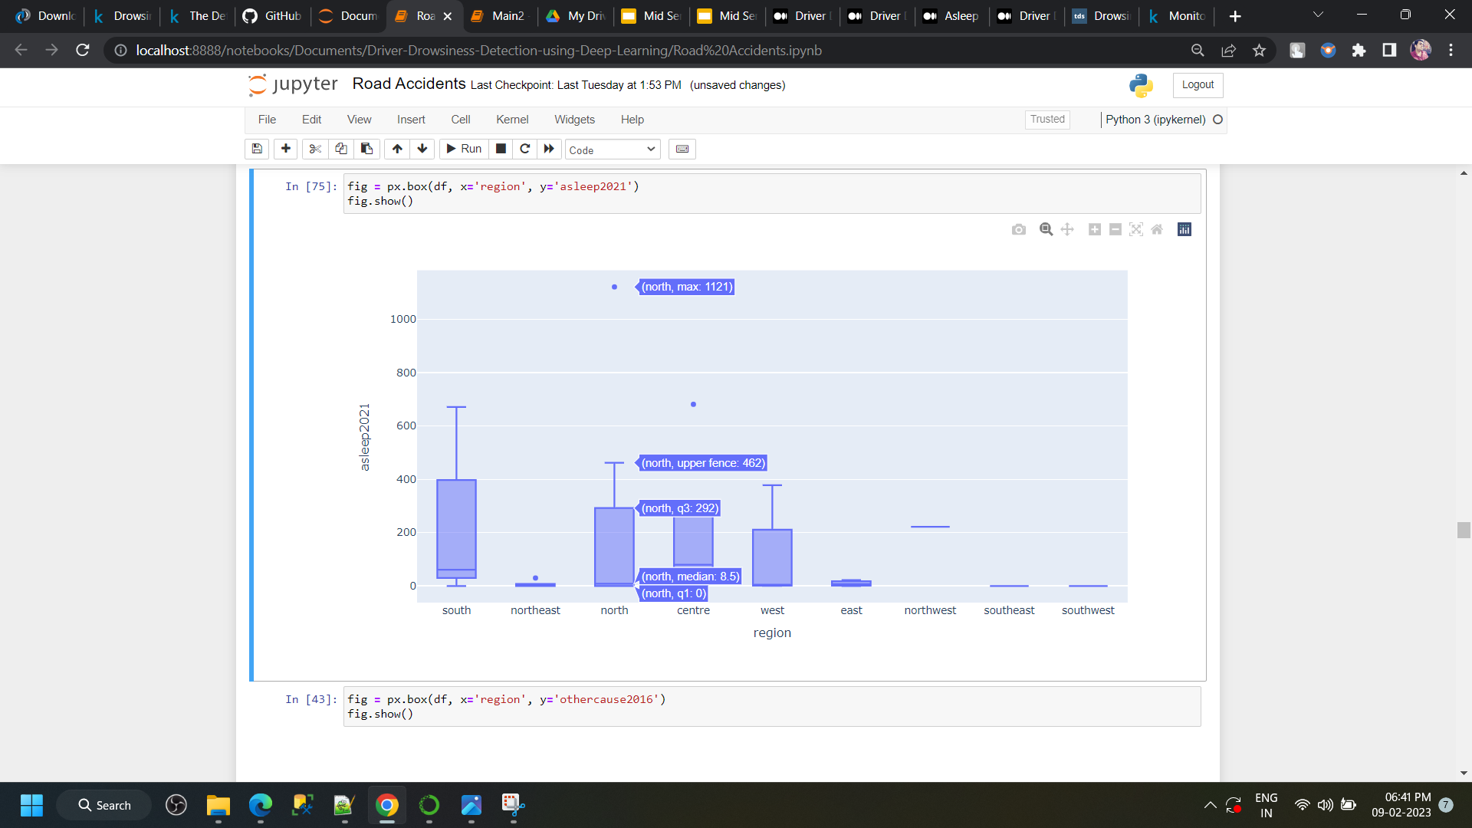
Statistics of Road Accident Caused By Drowsiness

Slide 22
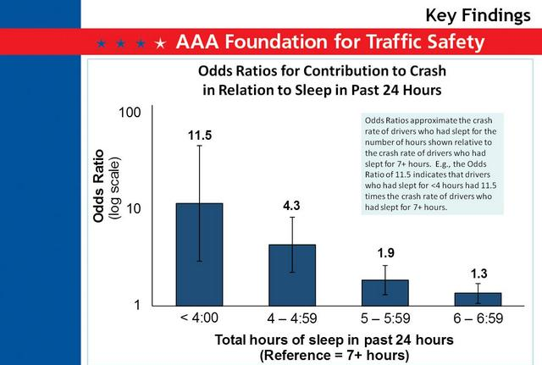
Statistics of Road Accident Caused By Drowsiness

Slide 23
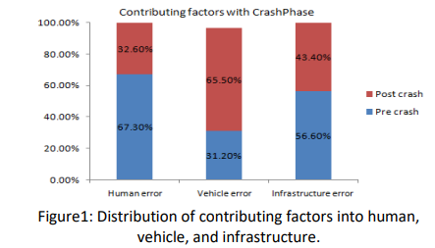
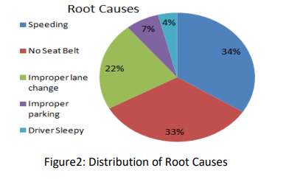
Statistics of Road Accident Caused By Drowsiness

Slide 24
Classification report for Computer Vison
 | Precision | Recall | F1-score | Support
Yawn | 0.75 | 0.92 | 0.83 | 63
No_yawn | 0.87 | 0.74 | 0.8 | 74
Closed | 0.92 | 0.94 | 0.93 | 215
Open | 0.96 | 0.93 | 0.94 | 226
Accuracy |  |  | 0.91 | 578
Macro avg | 0.88 | 0.88 | 0.88 | 578
Weighted avg | 0.91 | 0.91 | 0.91 | 578
The accuracy of the model during testing is 91%.The model is compiled using Gray Wolf Optimizer as it has yielded the best results based on Face and Eye Tracking.

Slide 25
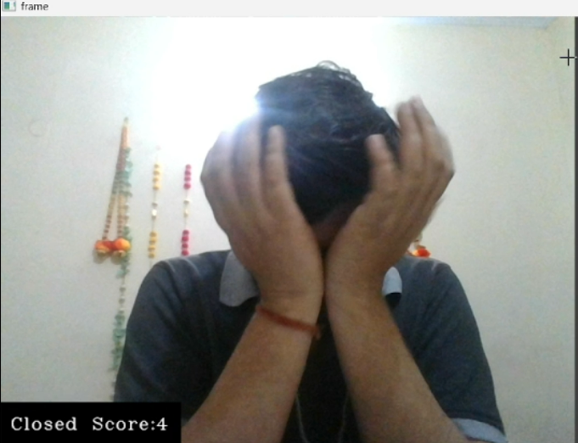
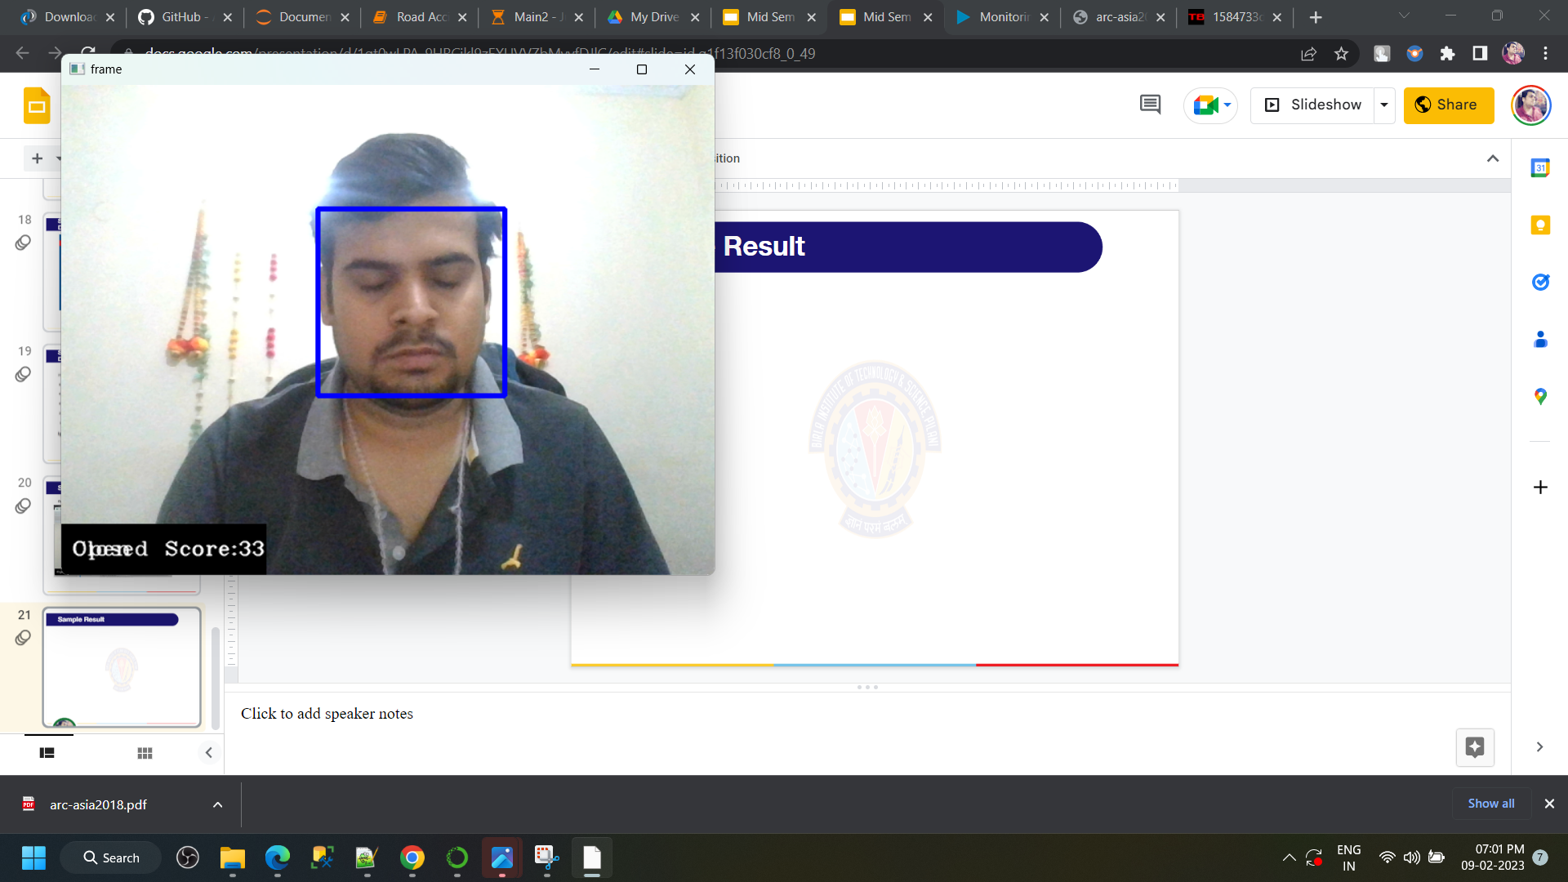
Sample Result
Closed Eye Eye Rub

Slide 26
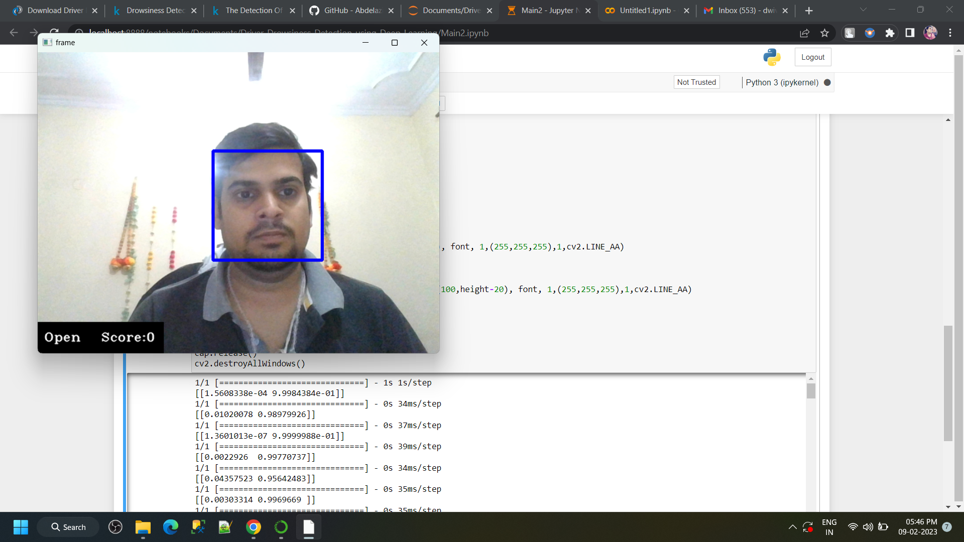
Sample Result
Open Eye

Slide 27
Conclusion
The process of drivers’ drowsiness detection is very important for both individual and community safety.
The growing use of Artificial Intelligence can be immensely useful in predicting fatigue of a driver.
Our model automatically predicts a driver as drowsy or not by recognizing and key features from its face and predicting the output in real-time with an accuracy of 73.2% using CNN.
By Using Computer Vison (Open CV) Gray Wolf Optimizer model, this predicts a driver as drowsy or not by recognizing and key features from its face and predicting the output in real-time with an accuracy of 91.2%.
It has various advantages as the installation is simple - of a camera, and it does not hinder the driver’s experience and comfort like in other techniques such as biological features or vehicle-based features.
Not prone to external disturbances, considers only the driver’s face.

Slide 28
LIMITATIONS:
The accuracy of the model degrades if the eye frames are not captured clearly due to any kind of obstacles such as goggles or spectacles having reflection). Camera operations such as auto adjustments with respect to zoom and rotation are not considered in conducting experiments. Once the eyes are localized, zooming in automatically will help increase the accuracy. The accuracy of detection of eyes and mouth reduces when the driver is not facing the camera.

Slide 29
Future Scope:
The system can be made more accurate using various other parameters such as State of the Car, Detecting Foreign Substances on Face etc.
An application can be developed where it can alert or prevent the user from sleeping.
It can be used to develop an IOT device that can be installed in the car to detect driver’s drowsiness.
Similar models and techniques can be used for various other uses such as Netflix, Hotstar and other streaming service platforms can detect whether the person is sleeping and stop the video accordingly.

Slide 30
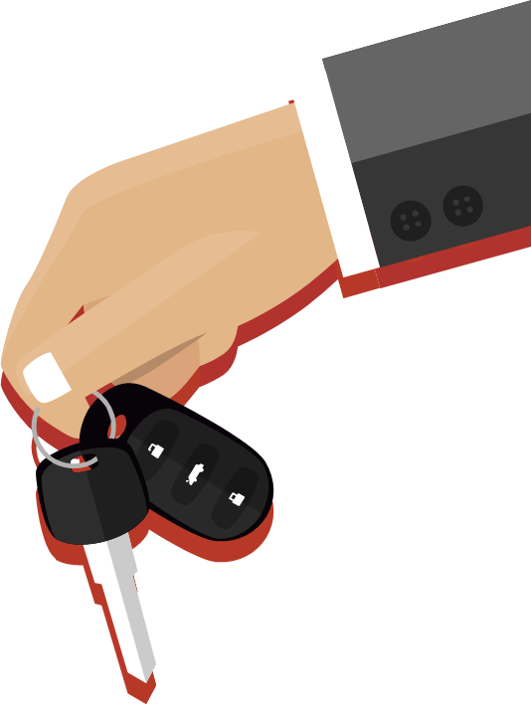
THANK YOU
Special thanks to
Dr Sarvamangala Hita

